Slide 1
Digital Transmission

Slide 2













































4-1 DIGITAL-TO-DIGITAL CONVERSION
In this section, we see how we can represent digital data by using digital signals. The conversion involves
three techniques: line coding, block coding, scrambling. Line coding is always needed;
and block
coding and scrambling may or may not be needed.
Topics discussed in this section:
Line Coding
Line Coding Schemes
Block Coding
Scrambling

Slide 3
Line Coding
Converting a string of 1‟s and 0‟s (digital data) into a sequence of signals that denote the 1‟s and 0‟s.
For example a high voltage level (+V) could represent a “1” and a low voltage level (0 or -V) could represent a “0”.

Slide 4
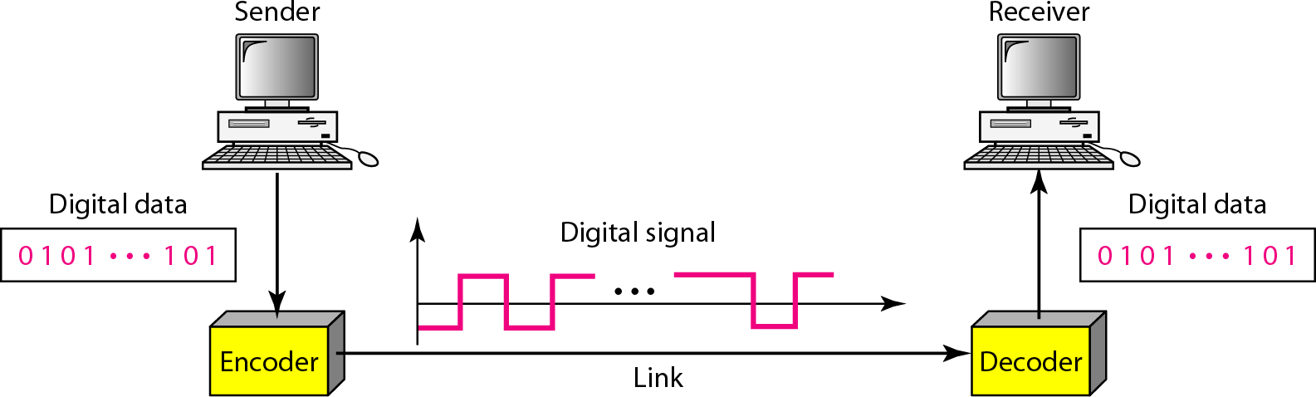
Figure 4.1 Line coding and decoding

Slide 5
Mapping Data symbols onto Signal levels
A data symbol (or element) can consist of a number of data bits:
1 , 0 or
11, 10, 01, ……
A data symbol can be coded into a single signal element or multiple signal elements
1 -> +V, 0 -> -V
1 -> +V and -V, 0 -> -V and +V
The ratio „r‟ is the number of data elements carried by a signal element.

Slide 6
Relationship between data rate and signal rate
The data rate defines the number of bits sent per sec - bps. It is often referred to the bit rate.
The signal rate is the number of signal elements sent in a second and is measured in bauds. It is also referred to as the modulation rate.
Goal is to increase the data rate whilst reducing the baud rate.

Slide 7
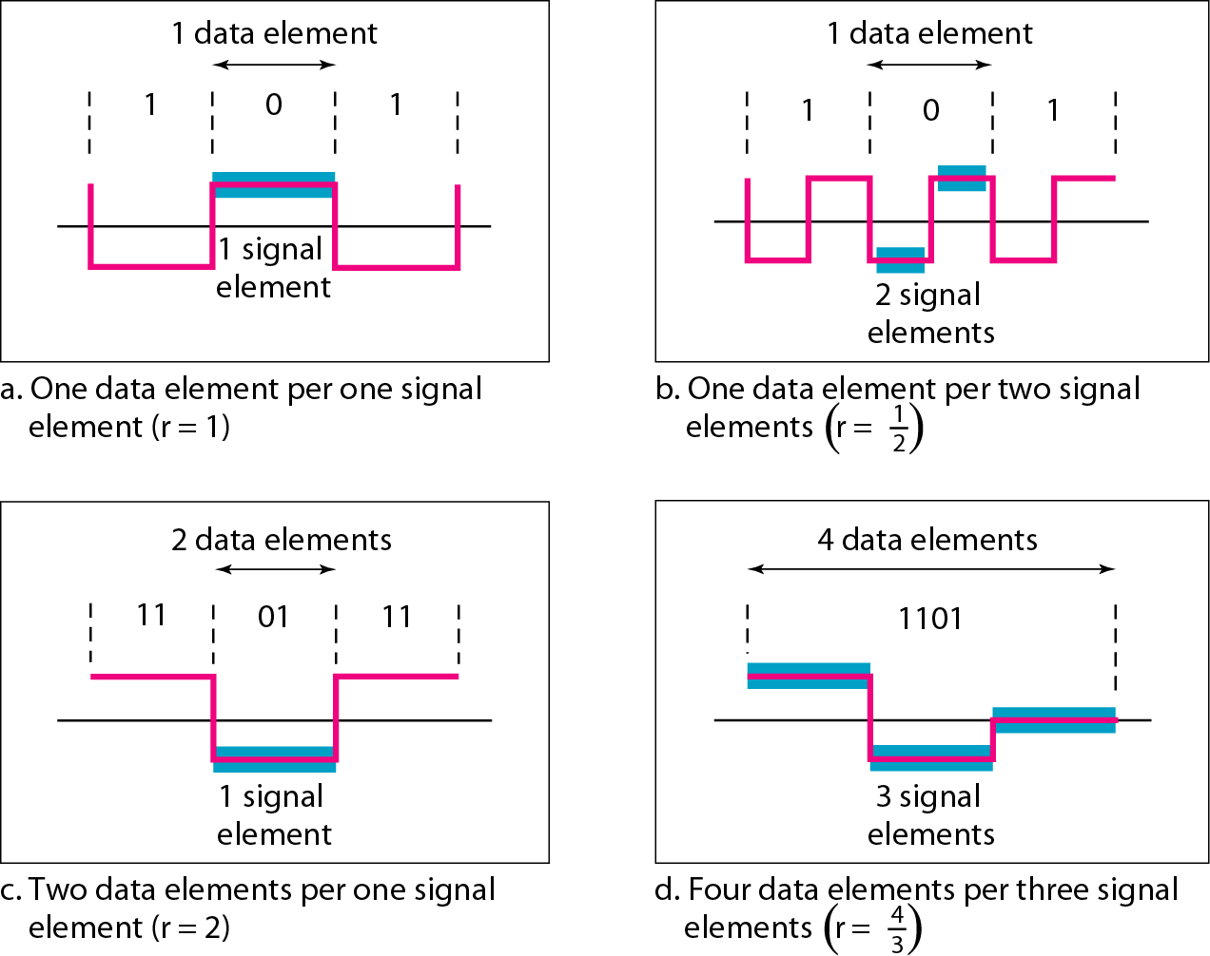
Figure 4.2 Signal element versus data element

Slide 8
Data rate and Baud rate
The baud or signal rate can be expressed as:
S = c x N x 1/r bauds where N is data rate
c is the case factor (worst, best & avg.)
r is the ratio between data element &
signal element

Slide 9



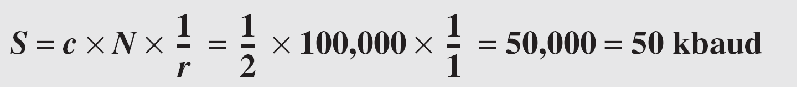
Example 4.1
A signal is carrying data in which one data element is encoded as one signal element ( r = 1). If the bit rate is 100 kbps, what is the average value of the baud rate if c is between 0 and 1?
Solution
We assume that the average value of c is 1/2 . The baud rate is then

Slide 10
Considerations for choosing a good signal element referred to as line encoding

Slide 11
Line encoding C/Cs
DC components - when the voltage level remains constant for long periods of time, there is an increase in the low frequencies of the signal. Most channels are bandpass and may not support the low frequencies.
This will require the removal of the dc component of a transmitted signal.

Slide 12
Line encoding C/Cs
Self synchronization - the clocks at the sender and the receiver must have the same bit interval.
If the receiver clock is faster or slower it will misinterpret the incoming bit stream.

Slide 13
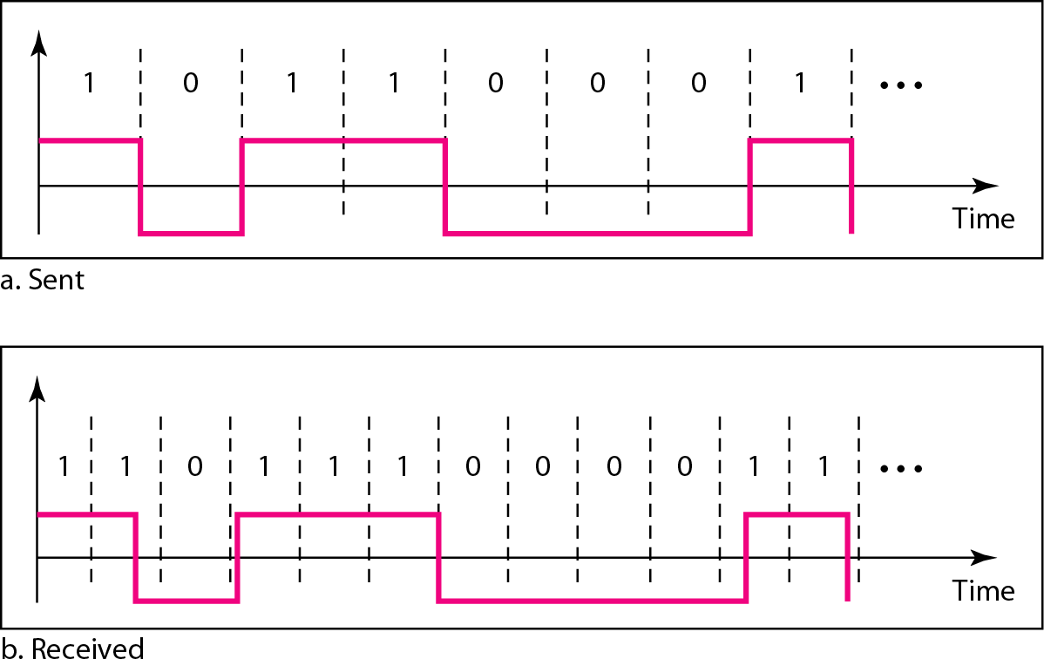
Figure 4.3 Effect of lack of synchronization

Slide 14
Example 4.3
In a digital transmission, the receiver clock is 0.1 percent faster than the sender clock. How many extra bits per second does the receiver receive if the data rate is 1 kbps? How many if the data rate is 1 Mbps?
Solution
At 1 kbps, the receiver receives 1001 bps instead of 1000 bps.
At 1 Mbps, the receiver receives 1,001,000 bps instead of 1,000,000 bps.

Slide 15
Line encoding C/Cs
Error detection - errors occur during transmission due to line impairments.
Some codes are constructed such that when an error occurs it can be detected. For example: a particular signal transition is not part of the code. When it occurs, the receiver will know that a symbol error has occurred.

Slide 16
Line encoding C/Cs
Noise and interference - there are line encoding techniques that make the transmitted signal “immune” to noise and interference.
This means that the signal cannot be corrupted, it is stronger than error detection.

Slide 17
Line encoding C/Cs
Complexity - the more robust and resilient the code, the more complex it is to implement and the price is often more than simple one.

Slide 18
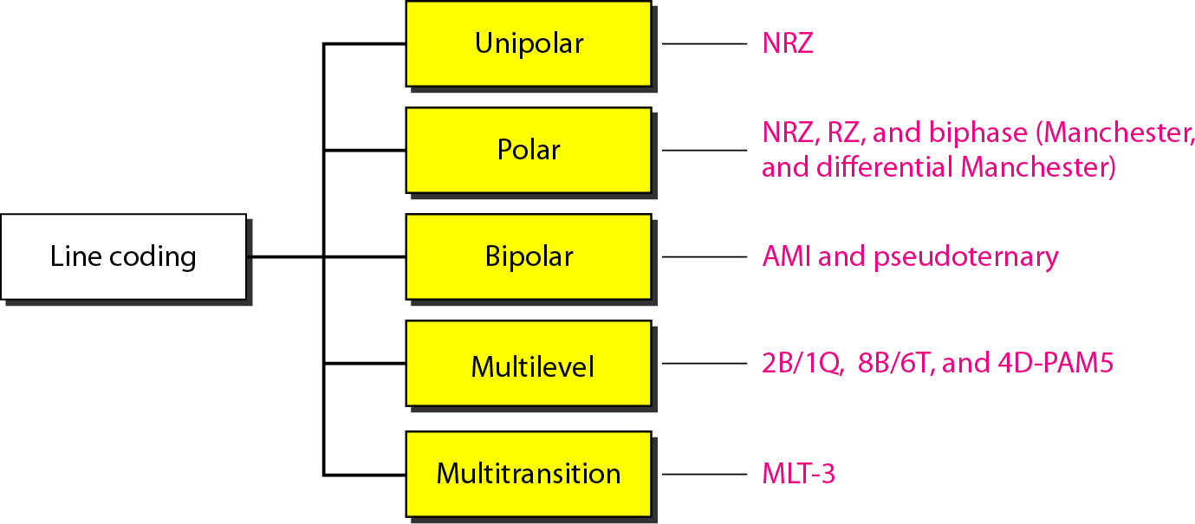
Figure 4.4 Line coding schemes

Slide 19
Unipolar
All signal levels are on one side of the time axis - either above or below
NRZ - Non Return to Zero scheme is an example of this code. The signal level does not return to zero during a symbol transmission.
Scheme is prone to DC components. It has no synchronization or any error detection. It is simple but costly in power consumption.

Slide 20
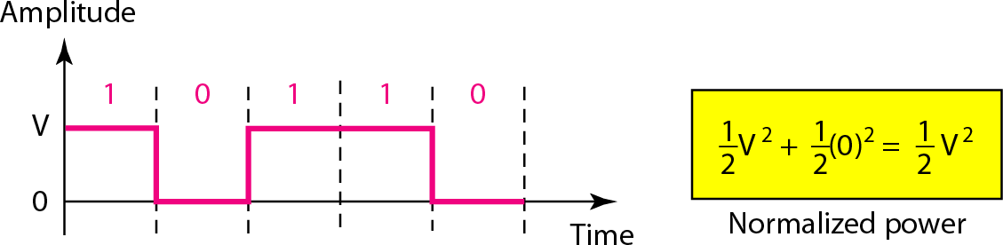
Figure 4.5 Unipolar NRZ scheme

Slide 21
Polar - NRZ
The voltages are on both sides of the time axis.
Polar NRZ scheme can be implemented with two voltages. E.g. +V for 1 and -V for 0.
There are two versions:
NZR - Level (NRZ-L) - positive voltage for one symbol and negative for the other
NRZ - Inversion (NRZ-I) - the change or lack of change in polarity determines the value of a symbol. E.g. a “1” symbol inverts the polarity a “0” does not.

Slide 22
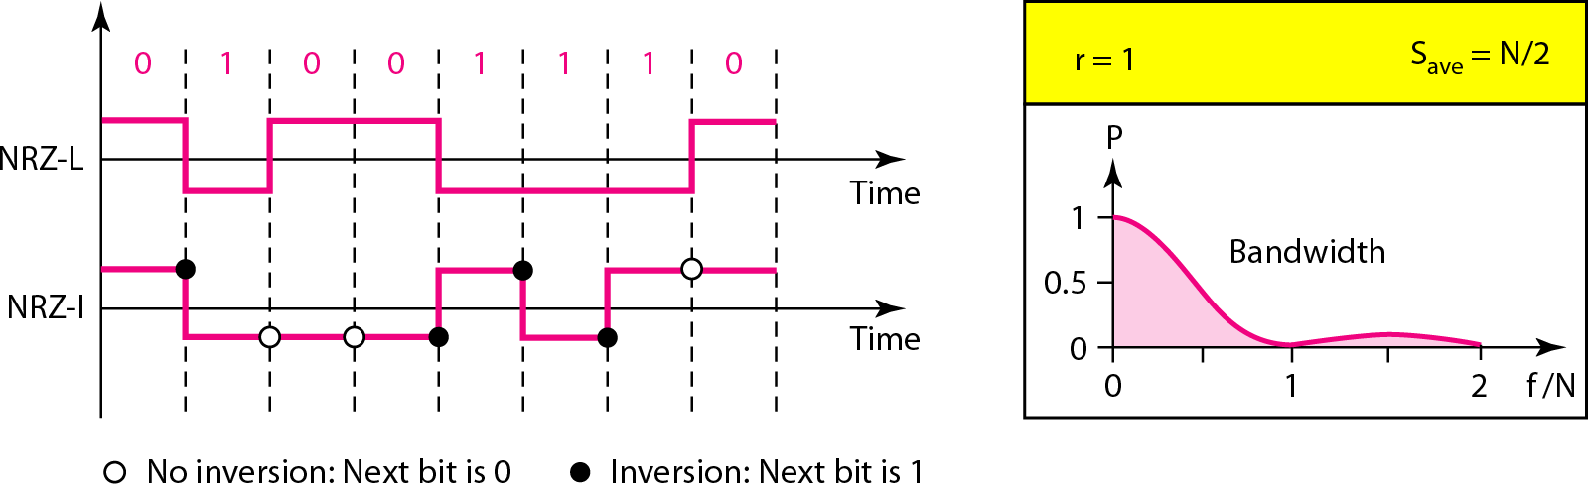
Figure 4.6 Polar NRZ-L and NRZ-I schemes

Slide 23

Note
In NRZ-L the level of the voltage determines the value of the bit.
In NRZ-I the inversion or the lack of inversion
determines the value of the bit.

Slide 24
Note
NRZ-L and NRZ-I both have an average signal rate of N/2 Bd.

Slide 25
Note
NRZ-L and NRZ-I both have a DC component problem, it is worse for NRZ-
L. Both have no self synchronization &no error detection. Both are relatively
simple to implement.

Slide 26
Polar - RZ
The Return to Zero (RZ) scheme uses three voltage values. +, 0, -.
Each symbol has a transition in the middle. Either from high to zero or from low to zero.
This scheme has more signal transitions (two per symbol) and therefore requires a wider bandwidth.
No DC components or baseline wandering.
Self synchronization - transition indicates symbol value.
More complex as it uses three voltage level. It has no error detection capability.

Slide 27
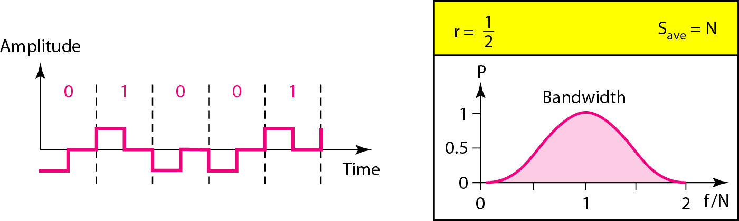
Figure 4.7 Polar RZ scheme

Slide 28
Polar - Biphase: Manchester and Differential Manchester
Manchester coding consists of combining the NRZ-L and RZ schemes.
Every symbol has a level transition in the middle: from high to low or low to high. Uses only two voltage levels.
Differential Manchester coding consists of combining the NRZ-I and RZ schemes.
Every symbol has a level transition in the middle. But the level at the beginning of the symbol is determined by the symbol value. One symbol causes a level change the other does not.

Slide 29
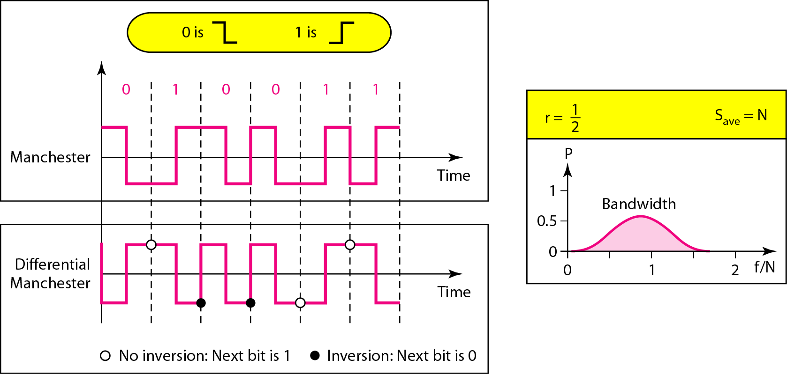
Figure 4.8 Polar biphase: Manchester and differential Manchester schemes

Slide 30
Note
In Manchester and differential Manchester encoding, the transition at the middle of the bit is used for synchronization.

Slide 31
Note
The minimum bandwidth of Manchester and differential Manchester is 2 times that of NRZ. The is no DC component.
None of these codes has error detection.

